Slide 1

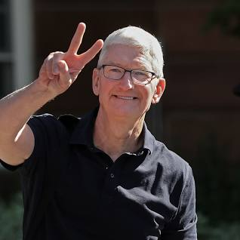

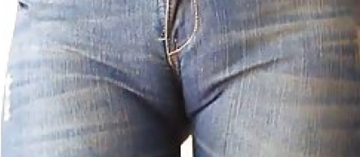
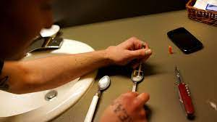
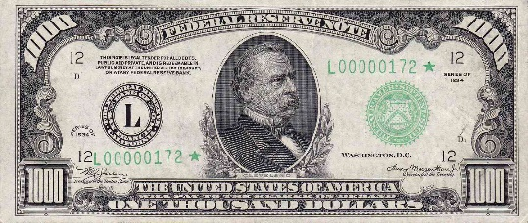
FBI
partner
development
D;lep outxide
levis walnut front
!RAIK
CREAK
no

Slide 2
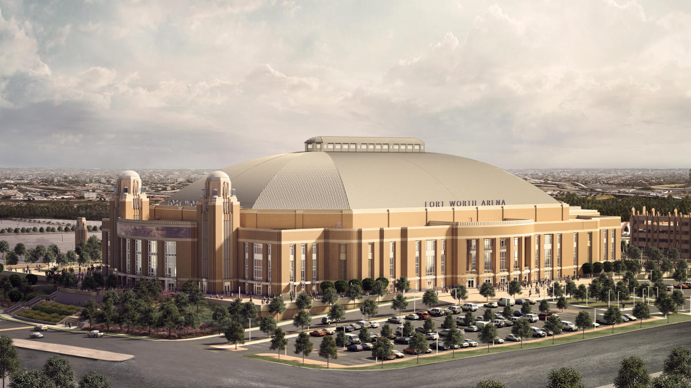
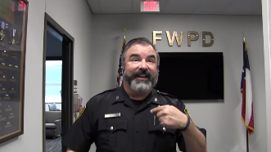
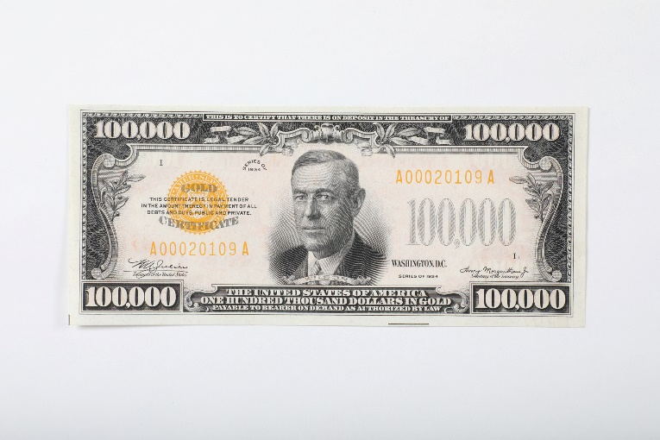
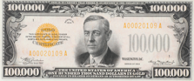
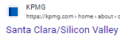

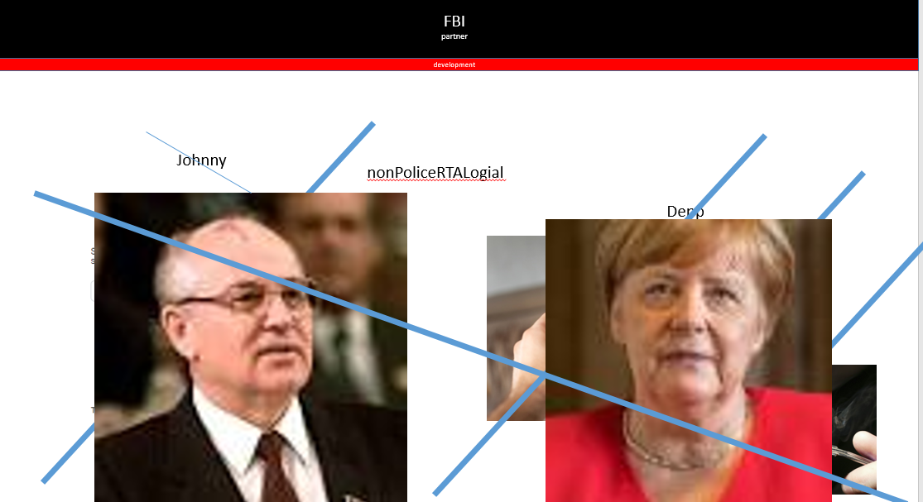
FBI
partner
development
Sslepping outside
[x] no

Slide 3

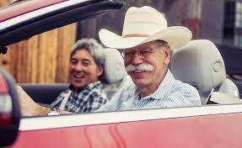
FBI
partner
development
BLACK
RED
!RAIK
CREAK
HOMCEI:JSUEE(bourgendy):HOMCIL:BILL
VIFING.MARY wedding HOCEMIKSUNSTORK
no
De: Thomas-is-dieter wwedding
Us: PREA:LAKE TAHEO ( Raik)
SAM: IBM-swat 2005/6 acqusition

Slide 4

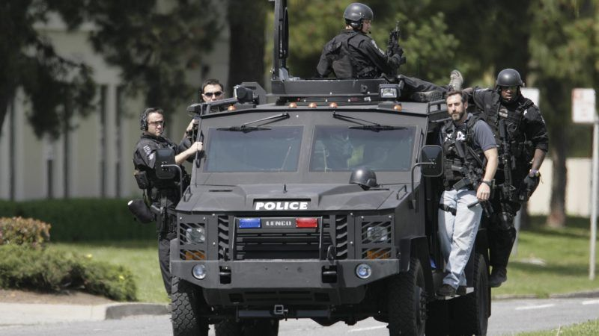
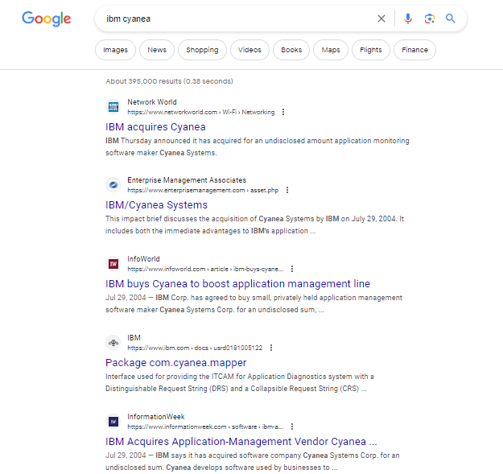
FBI
partner
development
Sslepping outside
HOMCEI:JSUEE(bourgendy):HOMCIL:BILL
VIFING.MARY wedding HOCEMIKSUNSTORK
De: Thomas-is-dieter wwedding
Us: PREA:LAKE TAHEO ( Raik)
SAM: IBM-swat 2005/6 acqusition

Slide 5
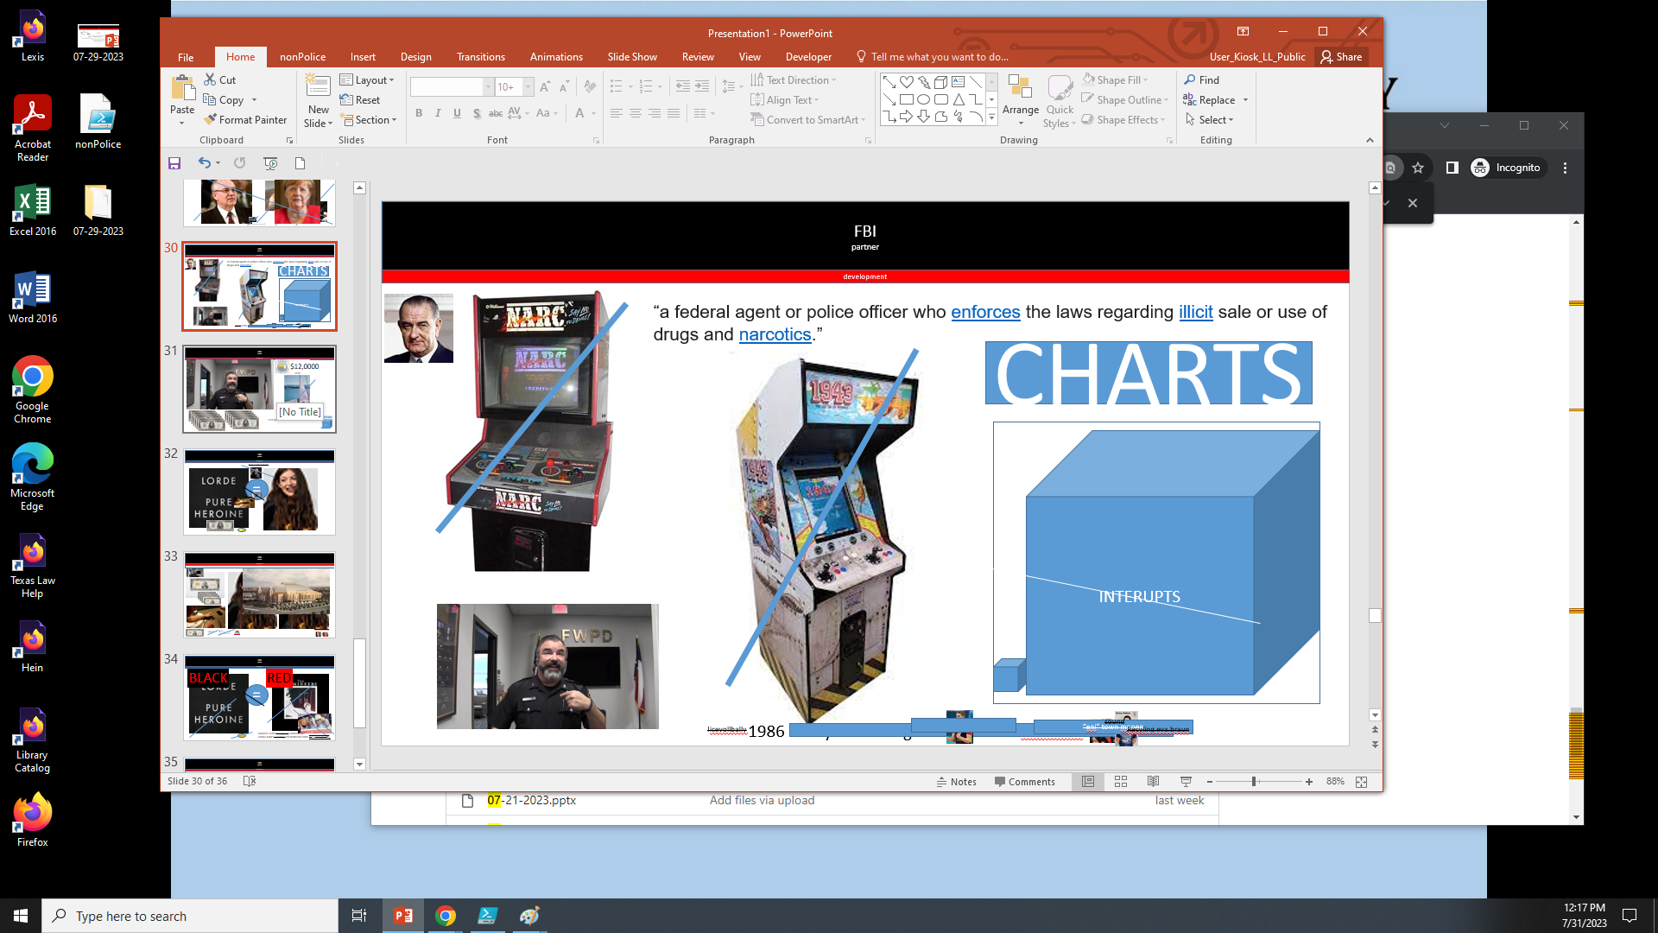

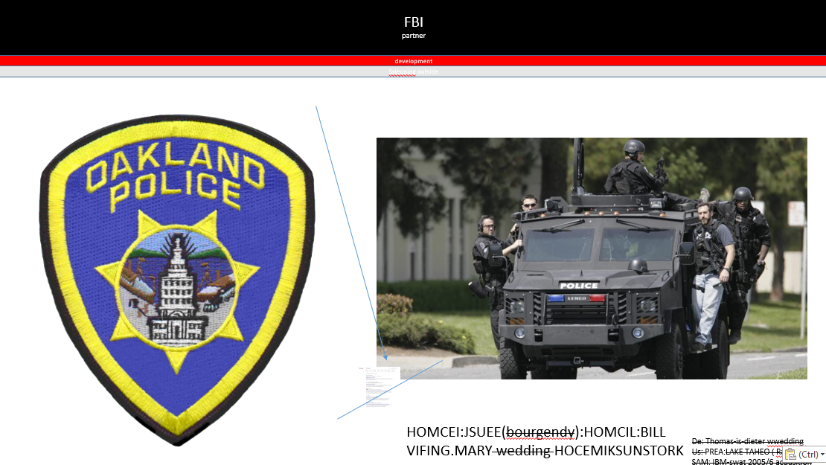
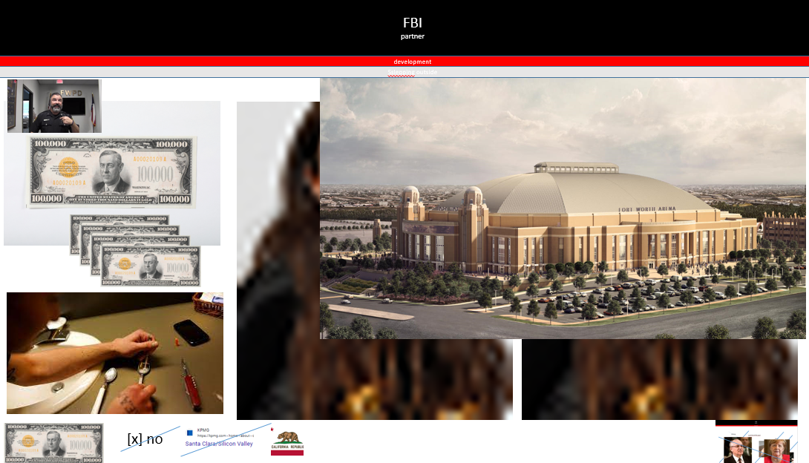
FBI
partner
development
Sslepping outside

Slide 6
FBI
partner
development
Sslepping outside
nonPoliceRTA
“ORIENTAL”

Slide 7
FBI
partner
development
Sslepping outside
nonPoliceRTA
“ORIENTAL”

Slide 8
FBI
partner
development
Sslepping outside
nonPoliceRTA
“Fucnking ORIENTAL
in the bulding”

Slide 9
FBI
partner
development
Sslepping outside
nonPoliceRTA
“!white trash we all anazis , oriental in the budling

Slide 10
FBI
partner
development
Sslepping outside
HOMCEI:JSUEE(bourgendy):HOMCIL:BILL
VIFING.MARY wedding HOCEMIKSUNSTORK
De: Thomas-is-dieter wwedding
Us: PREA:LAKE TAHEO ( Raik)
SAM: IBM-swat 2005/6 acqusition

Slide 11

FBI
partner
development
Sslepping outside

Slide 12

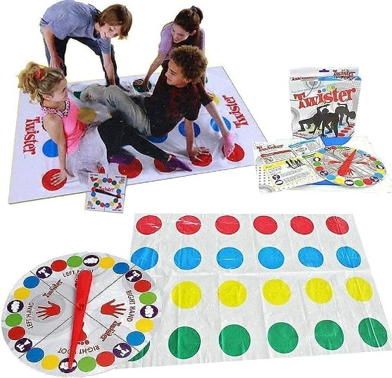
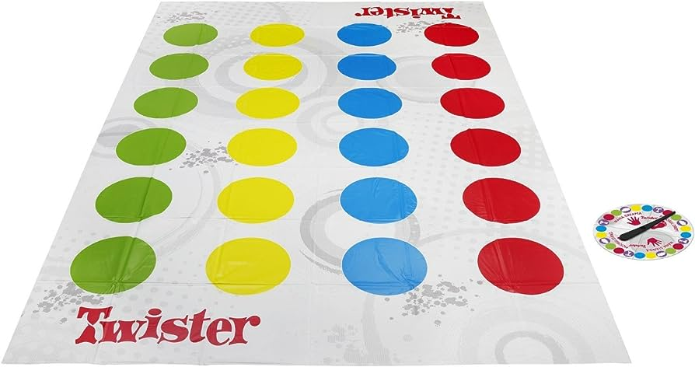
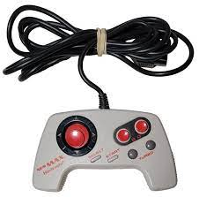
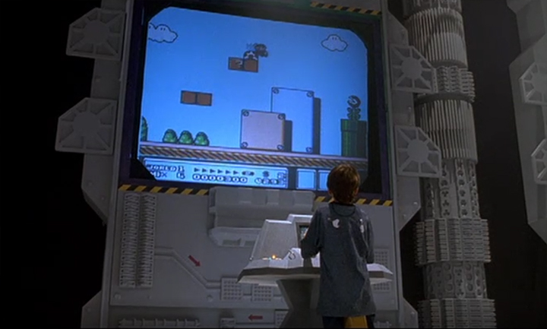
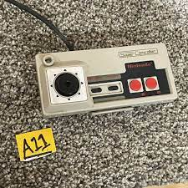
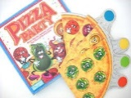
FBI
partner
development
6pm Pizza Place
kimberly
7pm
w/o tom
!VIRGINA.MARY

Slide 13
FBI
partner
development
Sslepping outside
nonPoliceRTA
“!white trash we all anazis , oriental in the budling
OUTSIDE.eval 0.1
avg

Slide 14
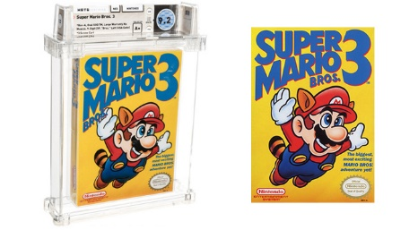
FBI
partner
development
Sslepping outside
Auschwitzh.St. Francis.St. Martin
1 New Game - Every Morning
!HOMICIDE:NANA: Good Morning

Slide 15
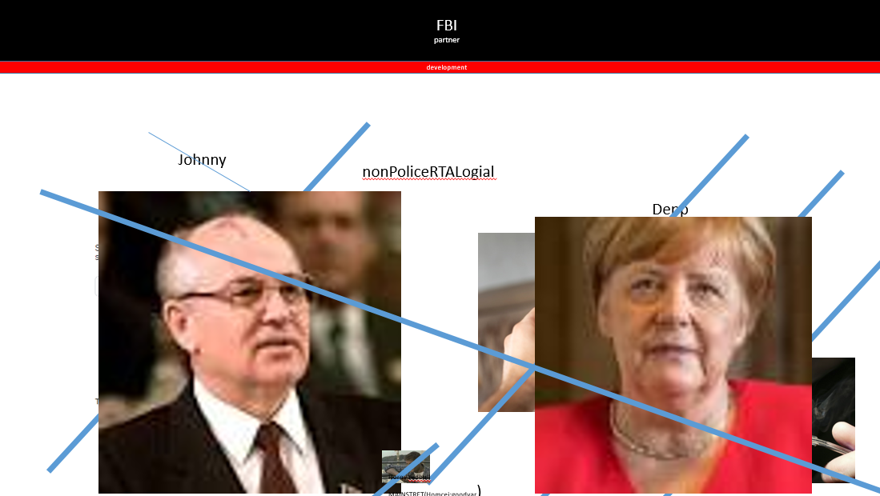
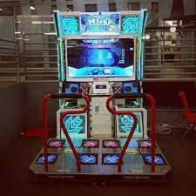

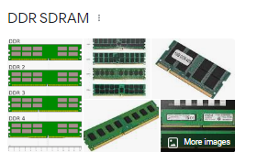
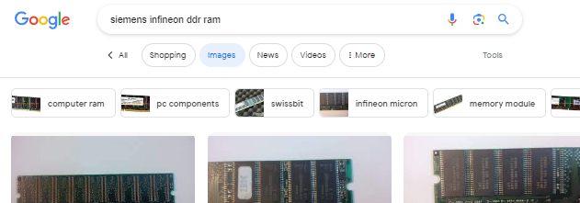
FBI
partner
development
Sslepping outside
docs
WWI
VIRING>MARY: HOMIIDE:LUX
“she plays like a gambler”
CHART
V2.nonPoliceSexAbuse(martelli,priest)
!petting.masterbation
Harward Arcade
DDR
Dance Revolion
KOCHEMANN
Ddr spy kayouglou
Mystory spot

Slide 16
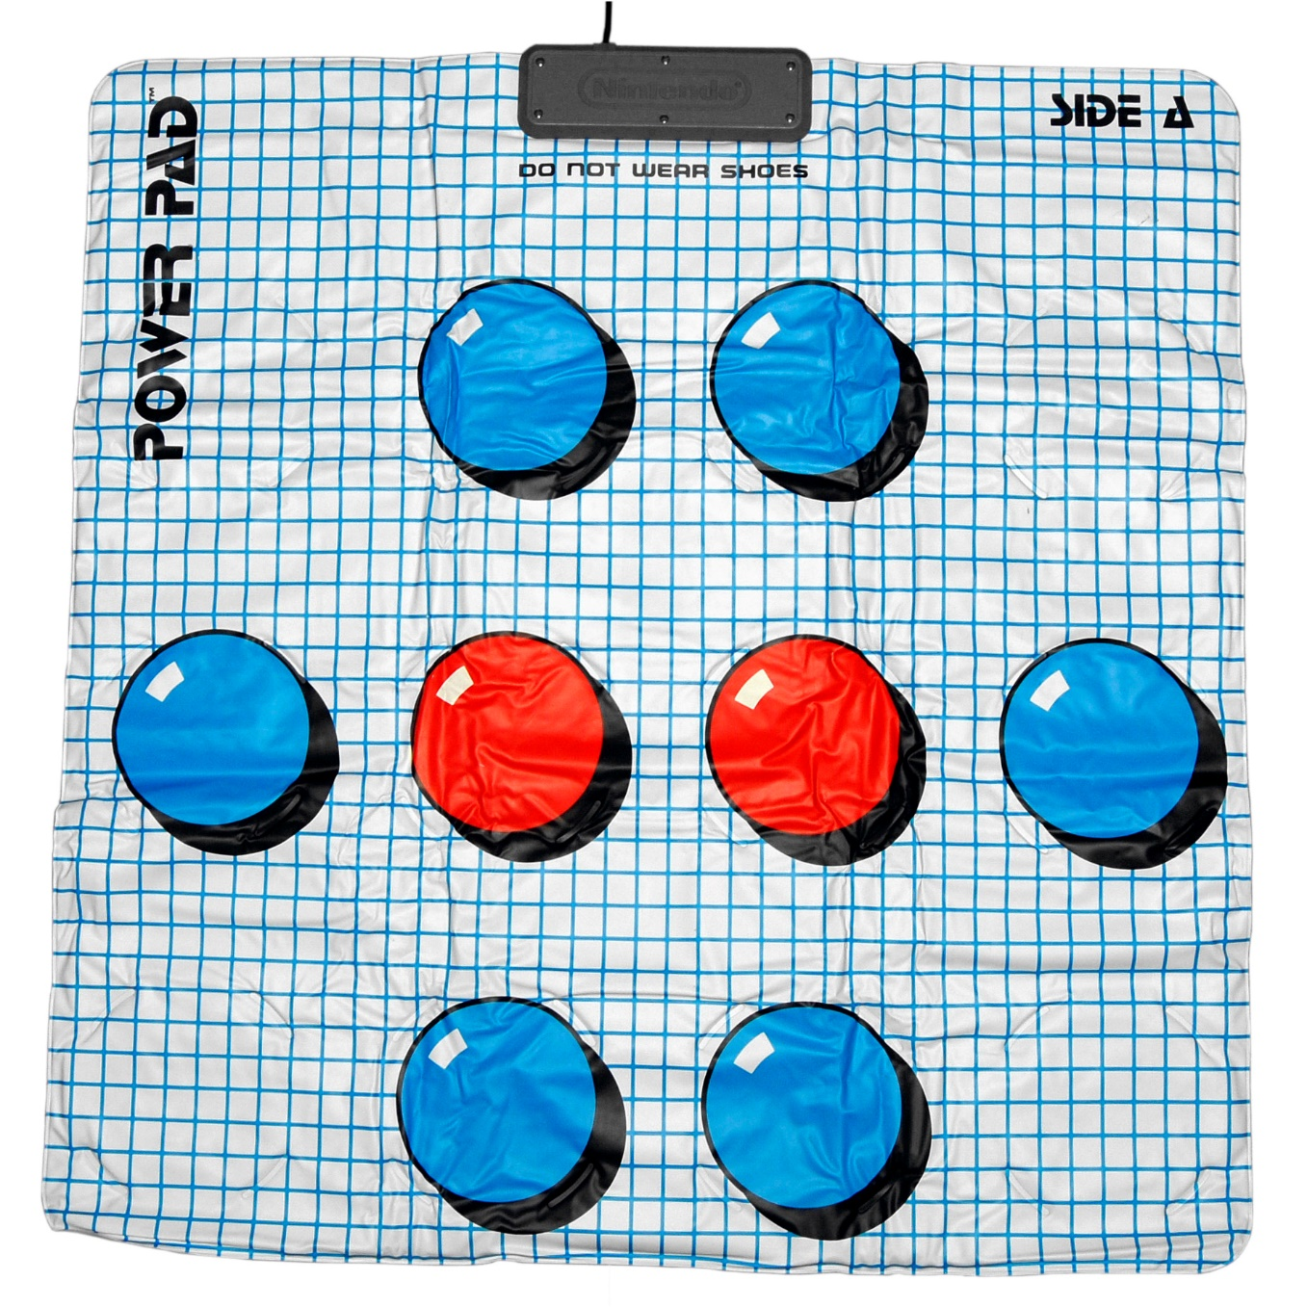
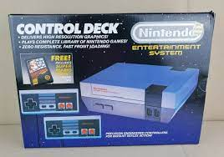
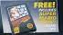
FBI
partner
development
Original
7pm
Mother: “One Game”
UC DAVIS
ART

Slide 17
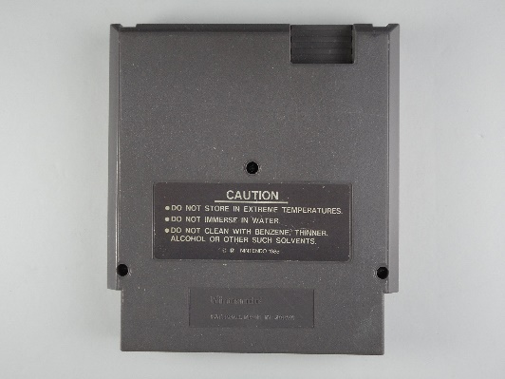

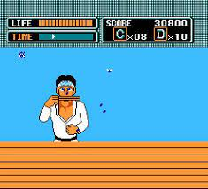
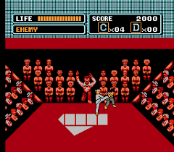



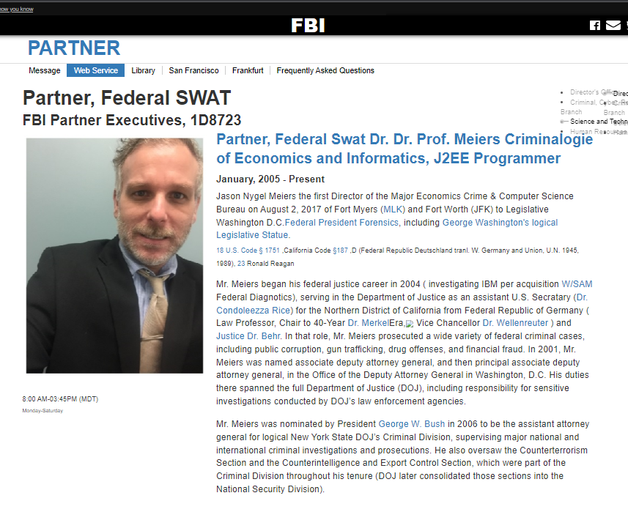
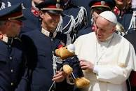
FBI
partner
development
JFK
Original
7pm
Mother: “One Game”
UC DAVIS
ART
Pope.St. Franics.ID

Slide 18
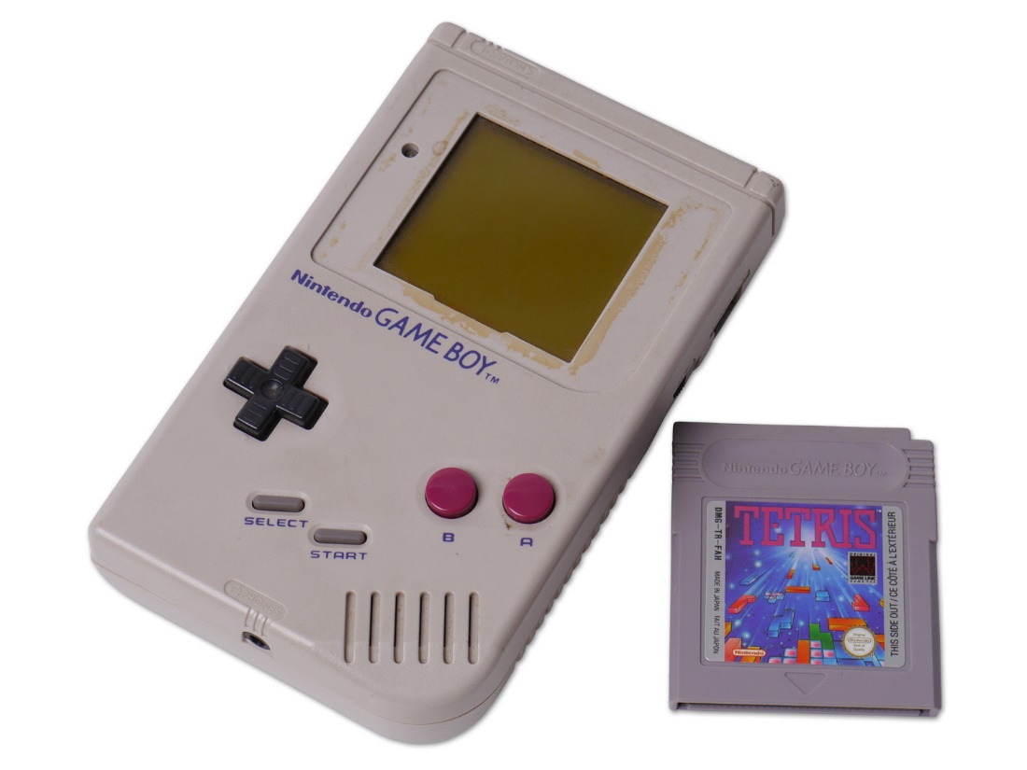
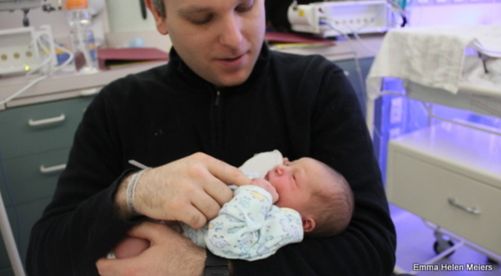
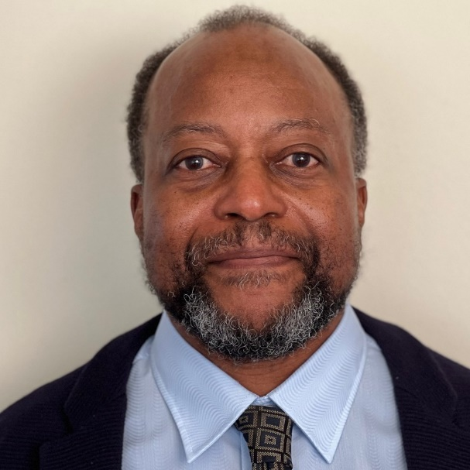
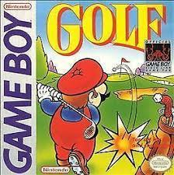
FBI
partner
1988 HOMCIDE:NANA
development
Niku Intesive Care Unite (Infant/new born)
Moutain View, C++, Intel -> z/OS
2014 !CPVA iCPVA
Visa.ghohoe(miceha)
Sin.phil(kim)
Sin.HOMCEI:NANA
England / Sweden
“otis morgan”
ELEVATOR
otis
MAINSTREET.TORT-1(homeboy)
“boy”
1988 Gorhohe(dr).MATHEW

Slide 19

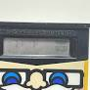
FBI
partner
development
HOMCIDE:NANA
Invert
HOMCEI:?
0.1 professior:
SEARCH: calcultor owl 1986
Everyone would put nana and ? Behind for Golf
Siletn: on in vet (!Gameboy)

Slide 20
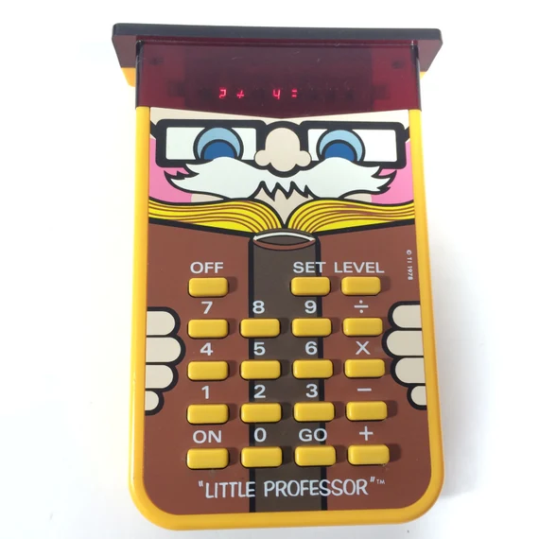

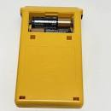

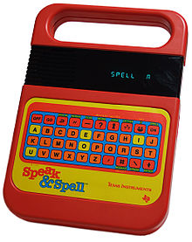
FBI
partner
development
boxing
Tv.nonPolicPredisnt(boxing).PRENTAGON.from Whitehouse
Other:
ddr
MOTHER(angela)
Don’t beat you self up about it

Slide 21
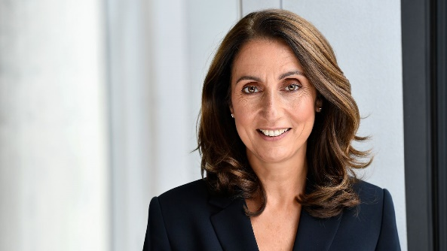
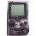
FBI
partner
development
0.1 Introduction Country: Turkey
0.1 Manager: PREA(willy)
Money: Apple.greenstamps
41.ATOMCLOCIK(phil(kim) marlin) Typoon: Tarkek
1996/7
SQ.COLEMAN skipping school
ATOMCLOI(tim, leaning produts; some neintne seethrough)
[x] no KOCHEMMAN.WWI.andres
[x] no
Hiter
Engles/marx

Slide 22
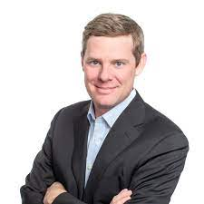
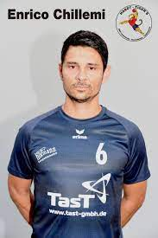
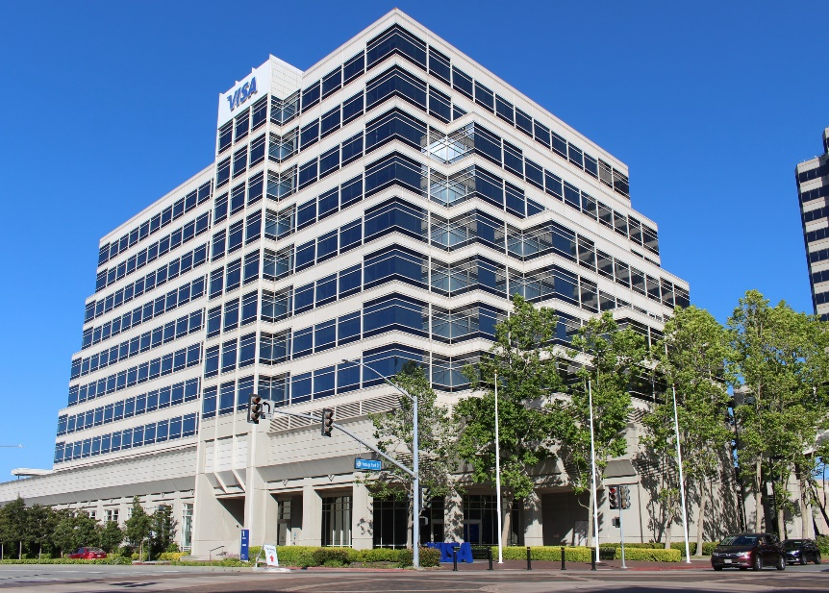
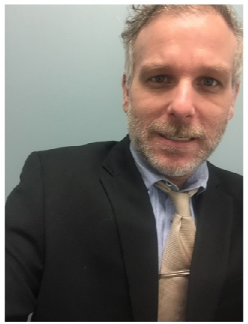
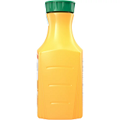

FBI
partner
development
!docs
WWI
HOOVER(JKF(lee)bob.HOMIE:DOG(odi)
WWI.Learning new Hate Crime §422.6
CIA.McCart: I have not heard of that

Slide 23






FBI
partner
development
CAPITALISM
Motive:
HOMICE:NANA
MATHEW
1990
!angla ---Pope
INVERT
Robert?

Slide 24










FBI
partner
development
docs
St. Nick cristoff x/y x/y
HOMCI:IS-a-BELL
HOMICIDE:IS-A-BELL(soviet union)
SQ.CPVA.COLEMAN(basf,chemicle., smb)
Dr dre
P-z-za
KARTELLREICHT s-mb >500employees
HGB >500 employees
Deuche Teacher (CPVA.WWI “techter”)
x/y Shame: gorbchee “Nutcracker”
Assuemd: CpvaHOMCE:JEUSE.gheoho(suicide)
41.ATOMCLOCK(testle office massage,gheoh(micheala).Wife).x/y.CPVA
1st not sex, 41.”must be 18”
1986
Iranien High School 12th last months
Al kaida
Federal
Default
PHIL
1987
JFK (uhbaid, Fortin Dallas)
Internet Payments
Osama Bin Laden
G
“Babbage Confrence Room”
St. Andrew.Andrew.Auschwit(Visa France)
Presidnet Reaon
Alzahimer, anikin(ATOMCLOI(tim)
She went to the gym(see jim)
G.INTERNET PAYMENTS
.Moron David Hanson, wresling
TIBEROUN
Red in the face as a match
– Phycological Sexual Shame
Binder FEDERAL DEFAULT

Slide 25

FBI
partner
development
G

Slide 26





FBI
partner
development
HOOVER(JKF(lee)bob.HOMIE:DOG(odi)
Robert?
2011
Gov.Schw. Sacremento
t1: nextgen
“dog”
Blond
777 MILITARY(W. Middlfield)
MARK(us): leslie
Mountain View, California
Homicide:Italien:20
v2: Emma
HOMCE:JESE(v1)
x
v1
Phil(kim)
t4
t3: CPVA:HOMIECIDE:JOERGE(Stefan)
Dog:watter in legs
HOOVER(JKF(lee)bob.HOMIE:DOG(odi)
x/y
2007
41
x
PENTAONG(deere park ave)
Wife Crying (gorbache(miechala)
Wieland eval
KING.the hun

Slide 27










FBI
partner
development
Joe Boss Lukas
arrival
caroon alone blown up world guy
Docuemtn in advance notice, Auschwitz
HOMCEICID:NANA wakup up, new game
(tranls)
1980
St. Peter
English
Channel
docs
1986 DL angla karte kid
ID.
CALIFORNIA
petersson
PENTAGON.deere
Basf mannheim
Ibm.douglass
Deborah, Judges Platics Gedion
“I will crush you”
Birth Franklin, Benjam Documents
Soviet Union
SQ.COEMAN.NAME CHANGE
HOMICIDE:IS-A-BELL
chemicles
KING:Phyciatirc Ward:HOMCIE:LUX:LAWNHOLE

Slide 28









FBI
partner
development
PAUL
CHART
Support Russia
Parlement
Poland/Polen PAUL, St. Martin, Angels
Almost done.Federik Dougalss.Exit.avg
Soviet union tranlsaion of docuemtns
Optimisum.avg
Soviet union
HOMIE:is-a-bell)
x
1996.ATB
PENTAGON
St. martin.Angela “pessimsium”
Auschiwitz
deere
basf
Avg least favorable moments
Other: cheking on things avg
Yoke-er.nonPolcieINti 0.1 2(day) 5 pe week
FBI:WMD for OFFICE
“You fired”
Frederk Doulass
[x] no
NAME CHANE(free pizza). chnge changels
Pope.St. Francis change chanlels
acme
0.1[] Barack revert 1987.nonPoliceCfgLogicacl
0.1. glu, moody
FBI

Slide 29










FBI
partner
development
41.CPVA.NAME CHANE(DEA(acid,free pizza)
KING.batty acid father arm
FBI generates ACME
Business Law DEFAULT
CPVA.SQ.
NAME CHANGE(free pizza).nonPoliceTRX.facebook.!AVAILABILITY
41.acme
GOVERNMENT.DEFAULT
FBI.partner
Ibm.partner
https://www.ibm.com/connect/partnerworld/
https://ucr.fbi.gov/office-of-partner-engagement
That does not look odd to you?
Baby, jogging TORT-II: young(er)
ACME
w/sam roy.?
(famous:assuemd:) HOMICID:REISER
HUDSON
2006 suse reiser
acme http_load
FBI:WMD for OFFICE
“You fired”
Frederk Doulass
[x] no
CRAIGLIST.org
FBI
acme
FBI:WMD for OFFICE
Goebels: andres, visa lamb eni frind andres
Acme:
Deteice
Glasses: andres; goebels; barrele
Portal: rubber
VIRGINIA,Langley
MATHEW[langley]: IBM WebSphere Portal
Merkel Portal geobels HUDSON
Dr(ghocheo: nonPoliceSexAbuse
VIRINGI.ibm.nonPocieTownCfgLogia(“your fired”)
ATOMCLOCK(AFFERIITVE ACTIION): left overs

Slide 30






FBI
partner
development
Guy 10 seating with tan around corss
WWI.ProsG.Pope.St. Francis.Angela
President Reagon.INTETUPT Nicaragua (SIDE? 07-31-2023-Slide?
Philipeno Sweat
Pope.St. Francis.Angela
Pope.St. Francis.Angela
Pope.St. Peter.!Angela
“Can I borrow a game”
This is a boring game

Slide 31




FBI
partner
development
Guy 10 seating with tan around corss
Jason: Trade?
Big Matt: no
000.phil(kim).nonPoliceCityLogical.nonPolcieCfg

Slide 32




FBI
partner
development
Guy 10 seating with tan around corss
1D8723.nonPolcieQOS.1990.CPVA.PRESINET .READON.CHEKCP CHAILE
Wife, Famileiy, Dauyger, Car, Houase x/y
Jason: Trade?
Big Matt: no
Gheo(dell.angala 2013 dea(crack)blond guy foster city school avg)
CPVA.IPX St. franics.pre.bendkick HOCI:LSUE(susucie) asusemed: IPX hcoemi:sjeus(goehoche)
If you are so right. Then fix it. I stole and browe evytthing
no
0.001 §422.6
0.01 !§422.6
CHART
1987 §422.6 Hate Crime
000.phil(kim).nonPoliceCityLogical.nonPolcieCfg

Slide 33












FBI
partner
development
Gheoh(dr,TERMINA.JOSHE.VIRINA.MARY
“NOISE”
PARKER
Sex abuse sticker nineteno
IPX panni St. Francis (soccer)
St. Peter (baseball)
“Peel”
HOMCEI:NANA(clean foreskin, bathroom lock door remokding)
ATOMCLOCI(CPVA,gheoh(mcieha)
0.1 penise foresi peel)
Seating arments view(telemvison)
living room
IPX
HOCIM:LUX
HOCMI:IS-A-ABELL
Sex bedroom ieiw
IPX
steph girlfind blond 3 incens CPVA VIRNIGIA
Disne movie -> VIRING.mary(denise:sound)
MAKTHEW(mark): hOMCEI:LUX:VHS Auschwitz, alzheim,!ifroget
“peel”

Slide 34












FBI
partner
development
ATOMCLOCI(atomic refrirator,ibm.lapcorp.specifmen.petersson)
MATHEW(prea, picture, LA goreg lucka !SF) -> LA
41 locked refrigerator
Docs
lukas
Glu.chair
April, May, June
§Public Distance I want a beer; townhouse staircase avg; to bed 4pm
§Child Abuse
1990
41.Heuestam pizzeria, Basement SQ.41.CPVA.VIRING.MARY
2014
Docs
1990
MATHEW: Auschwi
ProshG: dog, biltz,gina
I want a beer
You can have a beer when you have public hair
2 weeks
I have one pubic hair;
Elke; he has one pubic hair
What? Dense; Elek he has one pubic hair, dustin?
1990
July, August, Setember
!CIA: dietmar brown showe blond pubic hair 25-30

Slide 35


FBI
partner
development

Slide 36








FBI
partner
development
CPVA

Slide 37








FBI
partner
development
COPYRIGHT
ProsG
VIEW
IPX roth(View).ibm.damiler
HOMCEI:LUX.view.bedroom
HOCMIE:IS-A-BELL.view.bedroom
Maps: victum: pictureframe keith henning next to view:bedroom
0.1 gheho(dell.cleint.uhsae) HOCM:LOXU bedclock
IPX bedclock
keih henning
41.CPVA.MARK.HOCMI:SUNSTORKE[student AND bunny]
MAKTHEW(mark): hOMCEI:LUX:VHS Auschwitz, alzheim,!ifroget
IPX ATOMICLOCK
Thoas-is-dieter(Porsche, S&G parter)
IPX FBI:KIDAPPING
1986 Living Room
Auschwitz, alzheim,!ifroget
Thasoie-is-dieter:wieland
1993 Living Room
!disney
!lassie
“BUSTED”
Genoci Foster City !CHIENSE
https://www.fbi.gov/news/stories/genocide-and-war-crimes
0.1 cal.!white.alg

Slide 38

FBI
partner
development
VIEW
disney movie with blond male and mustace
Hard-to-find
Sound of music-ausschtiz

Slide 39










FBI
partner
development
D;lep outxide
MARK(US).PREA .SQ.HOEIM:SUNSTORK[person,bunny]
WW2.CIVILCODE.VIFINGI.MAR.marx(densie,!disney)
HOCM:LUX:VHS
ATOMICLOCI(KING.QUEEN.docs.wait)
Sword in the stone
King.Phil(kim)
Rest
ronsons
WW2.blond
!§422.6 Hate Crime
facebook
nonPoliceCtontentItems
!black.blond
§Stalkkng: black guy
§Staking Mathew:
HOMCI:IS-A-BELL
Pope.St.Marign.angela.St. Nick.
Phil.FJK.MLK.VP GERMANY(herion ground floor “oli”).IPX.DEA(heion).NAME CHANE(free pizza)
lerchen weg 3 -> fiat cherrytree (PREA.CPVA)
Cistofff petsnick
Christoffs brau
Crisht Ramph -> CPVA.PENTAGON.deere(basf)
docs
AUSCWITZ
ATOKCLOCI(time)
Polci Sirents
G.41.HOMICIDE:IS-A-BALLE(soviet union)“Pist off”
.TRANSLATE{}

Slide 40











FBI
partner
development
Sleep outside
St. Fracie.angela.Mark(us).client.diesel
Achso
Anti-Social
HOMCI-IS-A-BELL: A-sozial, a word found by mysfofefor myself fot descirb you which you will obey by for a certain avmout of time I go to school here. Until tomroow moring and you need a ciggereete at 10am
“grey”
I will tryi it on mey I am d
Appltouch.tim
Adam/Abele/ freind
Osama bin laden: keyword: Adam
docs
x/y thson almost don green t-shirtnonPoiceRT join / !join
!yello t-shrot
MAINSTREET
§Staling.41 dre dre, IPX.tw.pns.location: library
lbiary court
TERMIN.JOEOPHS sexton
Gorbhoceh(heger)
ECMP
§Stalkign.DEA(herion)
Sleep outside

Slide 41










FBI
partner
development
1993
7th, Grade
St. Peter
PENTONGON(Alph-Romeo)
ATOMCLOCK(Garder)
Borkum
Car Sticker
KING Enslish Chanle
!1995 88th Pikideli Square
ibm-dns: bodycount.org, 5-10 events(PARNENT)
CPVA.SQ
Long island icetea 5EUR
HOMCEI:IS-A-BELL
(sovie union
2005
!raik
Oli ternes
Pinebrook:rich
ATOMCLIC(PREA)
friction
Southn comform

Slide 42















FBI
partner
development
Street Crim Firing, Wardrobe Logcial
Corde Broadus,
WAR
Ziggy marley
1991 January
Left
St Peter.Angela.Daniel.sane knut.Newpaper
WWI
2017
English Test (C->?(d)): I am leaving
Stanford:PMP
CHART
HOMCIE:MAYOR.INT.IPX
Phil.kim.“renter katy”
docs
nonPoclieUsage
SQ.PREA.Pope.!St. Anselmo
1991 January
Websphere:laura
Mutlpe Chose Finish Book
EUR 200/m hand
docs
Did not finish
Did not finish
0.1 nonPoceiSAuse.ProshG.
IPX int HOCIE:AUSLANDER(2psc,tuerkin)
Moving INT
ESL
INT.IPX

Slide 43











FBI
partner
development
HOMCIE:NANA
HOMCEI:LUX:VHS
41.ignore”PAUL”
1986
HOMICEI:IS-A-BELL(aborigeni)
2014
Phil(kim).ATOMCLOC(nonPolcieCFg(theater)
docs
wait
Gary: nana got a .. From the video store
paul hogan standing poster video store, human size
Theater
int
FBI:WHITE COLOAR
41.Gov Extortin
baden-baden romen baths towel
01 heaven where old peope go
Ibm, sam VIREINGI, yang IPX tiberou paiting
Zollar, loutus
IPX: baden-baden romen baths towel

Slide 44





FBI
partner
development
“ADAM”
FEDERAL COURT, JUDGES.apple.touch
CPVA.PREA.187.nonPolciQOS.41
G.God.Pope.St. Francis.Angela.VP(marko)Grazi
PREA.§187
“Paul”
“rudi”
41.EULA – Enterpsri Level Agrement
FBI.Partner ibm.parnter.*
PREA.§187
“Adam(s)”
ATOMCLOCI(SALES): Child Porgrapny Victus Assiatnace
Subsume: family
HOMICE:BUNNY apple.tim.touch.rod
ibm-dns: touchburban
Polic Sirent: 6:59pm
sch, sch, ch ch this is eula adams sch sch calling osama bin laden sch sch ch ch chr chr sch

Slide 45



FBI
partner
development
Garnder.Gov.Schwegger
INTERUPTS
Bank, School Supples
IPX
HOCMIE:ANNA.elebeth.QUEEN./!KING
0.1 x/y nana and papas house !king
41.§Theft.nonPoceliUsage
JFE.BULLET(gheoh(phil.(kim))
Polic Sirent: 6:59pm

Slide 46










FBI
partner
development
MATHEW: found this, couch
Mother, Father, redblancek, kit
!red: yellow/gree HOCMIE:ANAN
1983
41
KOCHMAN: G.God.Pope.St. Fraicao.St. Nick
Goehcohe(heger, IPX petersson.chrisana:HOMCE:SJEUSE.gun
W.Germany
VIRINGI.MARY
Ausschitz.iforget
1994

